Slide 1


Slide 2


Slide 3



COLLECTIONS
IN JAVA

Slide 4


COLLECTIONS IN JAVA
The Java Collections Framework is a collection of interfaces and classes which helps in storing and processing the data efficiently
A Collection is a group of individual objects represented as a single unit
Java provides Collection Framework which defines several classes and interfaces to represent a group of objects as a single unit

Slide 5
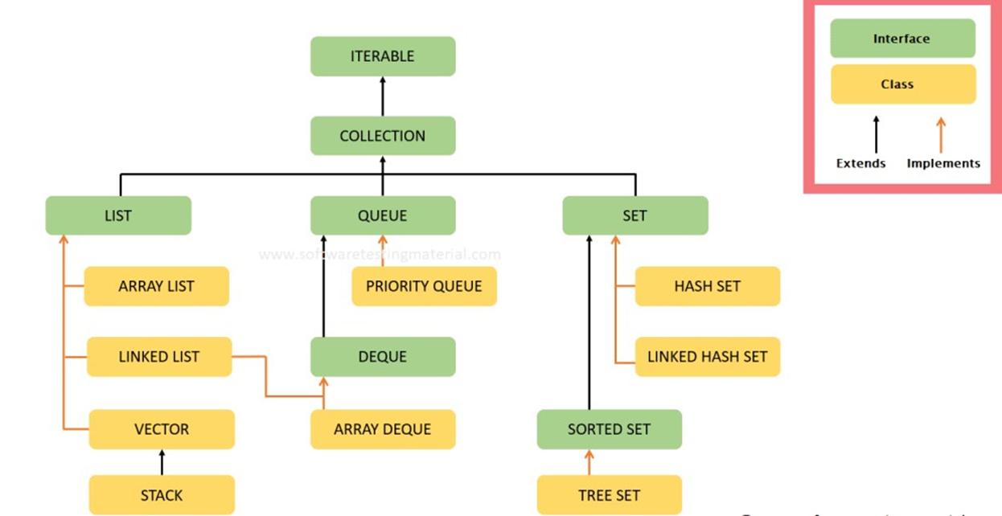
HIERARCHY

Slide 6
LIST IN JAVA
A List is an ordered Collection (sometimes called a sequence)
Lists may contain duplicate elements. Elements can be inserted or accessed by their position in the list, using a zero-based index
Types of List
Array List
Linked List

Slide 7
ARRAY LIST
Array list class implements List interface and it is based on an Array data structure
It is widely used because of the functionality and flexibility it offers
Array List is a resizable-array implementation of the List interface

Slide 8
CREATING AN ARRAY LIST
We can create an Array List by writing a simple statement like this
This statement creates an Array List with the name alist with type “String”
The type determines which type of elements the list will have
Since this list is of “String” type, the elements that are going to be added to this list will be of type “String”
ArrayList<String> alist=new ArrayList<String>();

Slide 9
ADDING ELEMENTS TO ARRAY LIST
We add elements to an ArrayList by using add() method
Example:
alist.add("Steve");
To add the element at the specified location in ArrayList, we can specify the index in the add method like this:
alist.add(3, "Steve"); //This will add "Steve" at the fourth position

Slide 10
EXAMPLE
Part of program
ArrayList<String> alist=new ArrayList<String>(); alist.add("Steve"); alist.add("Tim"); alist.add("Lucy"); //System.out.println(alist); //Adding "Steve" at the fourth position alist.add(3, "Steve"); //displaying elements System.out.println(alist)
Output:
[Steve, Tim, Lucy, Steve]
Note: Since the index starts with 0, index 3 would represent fourth position not 3.

Slide 11
REMOVING ELEMENTS FROM ARRAY LIST
remove() method to remove elements from an Array List
Syntax:
alist.remove(int index);

Slide 12
EXAMPLE
Part of program
ArrayList<String> alist=new ArrayList<String>(); alist.add("Steve"); alist.add("Tim"); alist.add("Lucy"); //Adding “Rose" at the fourth position alist.add(3, “Rose"); //displaying elements System.out.println(alist) alist.remove(“Tim”); System.out.println(alist);
Output:
[Steve, Tim, Lucy, Rose] [Steve, Lucy, Rose]
Note: Since the index starts with 0, index 3 would represent fourth position not 3.

Slide 13
METHODS IN ARRAY LIST
int indexOf(Object o): Gives the index of the object o. If the element is not found in the list then this method returns the value -1
This would give the index (position) of the string Tom in the list
boolean contains(Object o): It checks whether the given object o is present in the array list if its there then it returns true else it returns false
Syntax to sort the elements: Collections.sort(ref);
int pos = obj.indexOf("Tom");

Slide 14
public E get(int index)
E.get(int index)
Parameters:
index - index of the element to return
Returns:
the element at the specified position in this list
Throws:
IndexOutOfBoundsException - if the index is out of range (index < 0 || index >= size())

Slide 15
public E set(int index, E element)
public E set(int index, E element)
Parameters:
index - index of the element to replace
element - element to be stored at the specified position
Returns:
the element previously at the specified position
Throws:
IndexOutOfBoundsException - if the index is out of range (index < 0 || index >= size())

Slide 16
Programs:
Given an element write a program to check if element(value) exists in ArrayList, if it exists print the respective index value ?
Sort the arraylist in ascending order?
Write a program to print the combined array list by creating two arraylist.

Slide 17
Programs:
List<Integer> i=new ArrayList<>();
i.add(5);
i.add(8);
i.add(2);
i.add(5);
i.add(10);
System.out.println(i);
boolean a= i.contains(5); //To find the given value
if(a== true) {
int z= i.indexOf(5); //To find the index of given value.
System.out.println(z); }
Collections.sort(i);//To sort the elements
System.out.println(i);

Slide 18
Programs:
List<Integer> i=new ArrayList<>();
i.add(5);
i.add(8);
i.add(2);
i.add(5);
i.add(10);
System.out.println(i);
List<Integer> z=new ArrayList<>();
z.add(20);
z.add(28);
z.add(2);
z.add(15);
z.add(70);
System.out.println(z);
i.addAll(z);
System.out.println(i);

Slide 19
Iterator:
Different ways to print the elements in Collections
For each Loop
For Loop
Iterator
List Iterator

Slide 20
Syntax:
For each Loop:
for( element e : ref.variable)
{
System.out.println(e);
}
For Loop:
for( int i=0; i< refvariable.size(); i++)
{
System.out.println(refvariable.get(i));
}

Slide 21
Syntax:
Iterator:
Iterator e= refvariable.iterator();
While(e.hasNext())
{
System.out.println(e.next());
}

Slide 22
Syntax:
List Iterator:
List Iterator e= refvariable.listIterator();
While(e.hasNext())
{
System.out.println(e.next());
}
While(e.hasPrevious())
{
System.out.println(e.previous());
}

Slide 23
Scanner Class:
List <Integer> e = new ArrayList<>();
Scanner Sc=new Scanner(System.in);
While(sc.hasNextInt()){
e.add(sc.nextInt());}
System.out.println(e);
To sort in descending order
Collections.sort(refvariable,Collections.reverseOrder());
System.out.println(refvariable);

Slide 24
Using Arrays.asList: Syntax:
ArrayList<Type> obj = new ArrayList<Type>( Arrays.asList(Object o1, Object o2, Object o3, ....so on));
Program :
import java.util.*; public class InitializationExample1 { public static void main(String args[]) { ArrayList<String> obj = new ArrayList<String>( Arrays.asList("Pratap", "Peter", "Harsh")); System.out.println("Elements are:"+obj); } } // Elements are:[Pratap, Peter, Harsh]

Slide 25
COLLECTION.NCOPIES()
Collections.ncopies method can be used when we need to initialize the ArrayList with the same value for all of its elements
Syntax:
count is number of elements and element is the item value
ArrayList<T> obj = new ArrayList<T>(Collections.nCopies(count, element));

Slide 26
Collections.ncopies()
import java.util.*; public class Details { public static void main(String args[]) { ArrayList<Integer> intlist = new ArrayList<Integer>(Collections.nCopies(10, 5)); System.out.println("ArrayList items: "+intlist); } }
ArrayList items: [5, 5, 5, 5, 5, 5, 5, 5, 5, 5]

Slide 27
Sublist :
Syntax:
List subList(int fromIndex, int toIndex);
List<T> obj = new ArrayList<T>(); List<T> obj1 =obj.subList(fromindex, toindex);

Slide 28
ANONYMOUS INNER CLASS METHOD
Anonymous inner class method to initialize Array List
Syntax:
ArrayList<T> obj = new ArrayList<T>(){ { add(Object o1); add(Object o2); add(Object o3); ... ... } };

Slide 29
INITIALIZATION
import java.util.*; public class InitializationExample2 { public static void main(String args[]) { ArrayList<String> cities = new ArrayList<String>(){{ add("Delhi"); add("Agra"); add("Chennai"); }}; System.out.println("Content of Array list cities:"+cities); } }
Content of Array list cities:[Delhi, Agra, Chennai]

Slide 30
Program :
For this problem, we have 2 types of queries you can perform on a List: 1.Insert y at index x: Insert x y 2. Delete the element at index x: Delete x Given a list L, of N integers, perform Q queries on the list. Once all queries are completed, print the modified list as a single line of space-separated integers.

Slide 31
Program :
Input Format The first line contains an integer, N (the initial number of elements in L ). The second line contains N space-separated integers describing L. The third line contains an integer Q (the number of queries). The 2Q subsequent lines describe the queries, and each query is described over two lines: If the first line of a query contains the String Insert, then the second line contains two space separated integers x y , and the value y must be inserted into L at index x . If the first line of a query contains the String Delete, then the second line contains index x, whose element must be deleted from L .

Slide 32
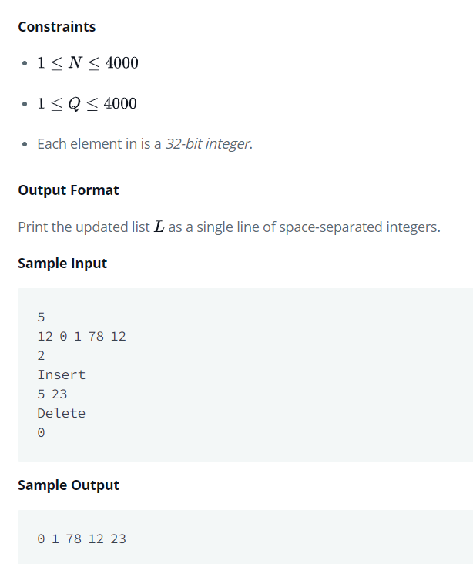
Program :

Slide 33
Program :
List<Integer> i=new ArrayList<>();
Scanner sc=new Scanner(System.in);
System.out.println("enter the number of elements ");
sc.nextInt();
System.out.println("enter the values");
while(sc.hasNextInt())
i.add(sc.nextInt());
System.out.println(i);
Scanner d=new Scanner(System.in);
System.out.println("enter the number of query");
d.nextInt();
System.out.println("enter the qurey");
String s=d.next();
if(s.equals("insert"){
System.out.println("enter the index value");
int a=d.nextInt();
System.out.println("enter the value");
int b=d.nextInt();
i.add(a,b);}
else{
System.out.println("enter the index value to delete");
int c=d.nextInt();
i.remove(c);}
for(int x:i){
System.out.print(x + " " );
}

Slide 34
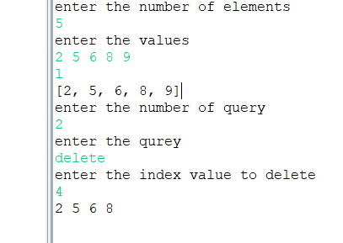
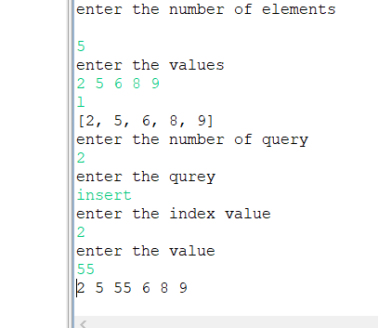
Program :

Slide 35
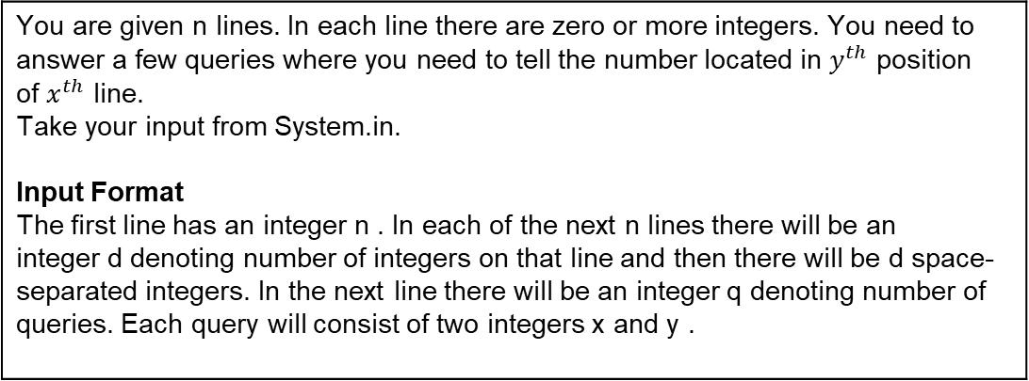
Program :
You are given n lines. In each line there are zero or more integers. You need to answer a few queries where you need to tell the number located in $y^{th}$ position of $x^{th}$ line. Take your input from System.in. Input Format The first line has an integer n . In each of the next n lines there will be an integer d denoting number of integers on that line and then there will be d space-separated integers. In the next line there will be an integer q denoting number of queries. Each query will consist of two integers x and y .

Slide 36
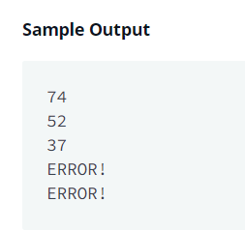
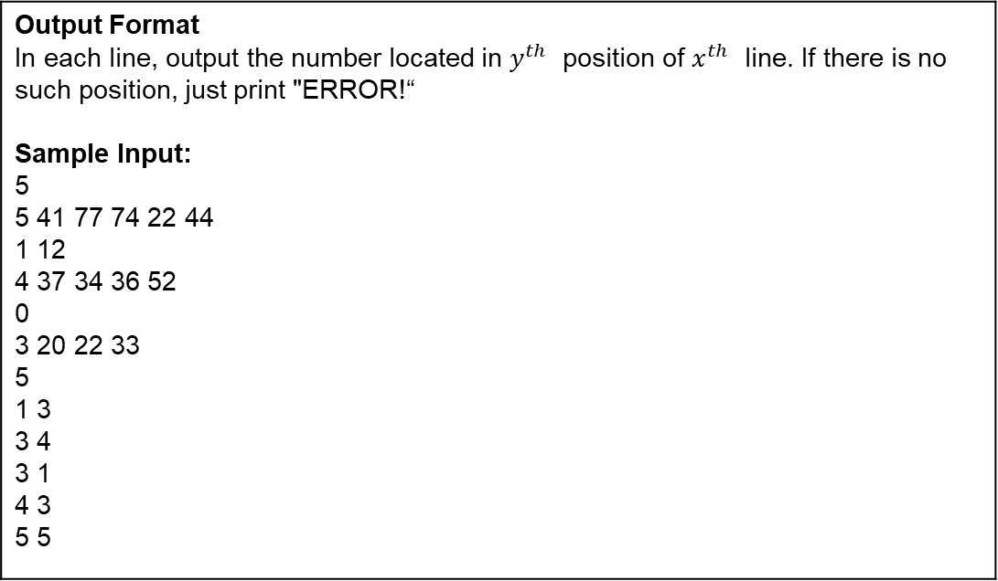
Program :
Output Format In each line, output the number located in $y^{th}$ position of $x^{th}$ line. If there is no such position, just print "ERROR!“ Sample Input: 5 5 41 77 74 22 44 1 12 4 37 34 36 52 0 3 20 22 33 5 1 3 3 4 3 1 4 3 5 5

Slide 37
Program :
Scanner sc = new Scanner(System.in);
int numLines = sc.nextInt();
ArrayList<ArrayList> listArray = new ArrayList<ArrayList>();
for(int i = 0;i<numLines;i++){
int numOfIntegers = sc.nextInt();
ArrayList<Integer> intArrayList = new ArrayList<Integer>();
for(int j=0;j<numOfIntegers;j++){
intArrayList.add(sc.nextInt());
}
listArray.add(intArrayList);
}
int numQueries =sc.nextInt();
for(int i=0;i<numQueries;i++){
int x = sc.nextInt-1();
int y = sc.nextInt-1();
sc.nextLine();
if(x<listArray.size() && y<listArray.get(x).size()){
System.out.println(listArray.get(x).get(y));
}else{
System.out.println("ERROR!");
}
}

Slide 38
LINKED LIST IN JAVA

Slide 39
LINKED LIST
LinkedList is a linear data structure
However LinkedList elements are not stored in contiguous locations like arrays, they are linked with each other using pointers

Slide 40
NEED OF LINKED LIST
Arrays which is also a linear data structure but arrays have certain limitations such as
Size of the array is fixed
Array elements need contiguous memory locations to store their values

Slide 41
CONSTRUCTOR DETAILS
Constructs an empty list
public LinkedList()

Slide 42
CONSTRUCTOR DETAILS
public LinkedList(Collection<? extends E> c)
Constructs a list containing the elements of the specified collection, in the order they are returned by the collection's iterator.
Parameters:
c - the collection whose elements are to be placed into this list
Throws:
NullPointerException - if the specified collection is null

Slide 43
ITERATOR
‘Iterator’ is an interface which belongs to collection framework.
It allows us to traverse the collection, access the data element and remove the data elements of the collection.
It returns true if Iterator has more element to iterate.
boolean hasNext():

Slide 44
METHODS OF LINKED LIST
Object next(): It returns the next element in the collection until the hasNext()method return true. This method throws ‘NoSuchElementException’ if there is no next element
void remove(): It removes the current element in the collection. This method throws ‘IllegalStateException’ if this function is called before next( ) is invoked

Slide 45
METHODS OF LINKED LIST
boolean add(Object item) | Object clone()
void add(int index, Object item) | boolean contains(Object item)
boolean addAll(Collection c) | Object get(int index):
boolean addAll(int index, Collection c) | Object getFirst()
void addFirst(Object item) | int indexOf(Object item)
void addLast(Object item) | Object pollFirst()

Slide 46
METHODS IN DETAIL
Returns the first element in this list.
Specified by:
getFirst in interface Deque<E>
Returns:
The first element in this list
throws :
Exception-if list is empty
public E getFirst()

Slide 47
getlast
Returns the last element in this list.
Specified by:
getLast in interface Deque<E>
Returns:
The last element in this list
Throws:
No SuchElementException - if this list is empty
public E getLast()

Slide 48
Indexof()
public int lastIndexOf(Object o)
Returns:
The index of the last occurrence of the specified element in this list, or -1 if this list does not contain the element.
Parameters:
o - element to search for

Slide 49
Example Snippet
LinkedList<String> linkedlist = new LinkedList<String>(); // Step2: Add elements to LinkedList linkedlist.add("Tim"); linkedlist.add("Rock"); linkedlist.add("Hulk"); linkedlist.add("Rock"); linkedlist.add("James"); linkedlist.add("Rock"); //Searching first occurrence of element int firstIndex = linkedlist.indexOf("Rock"); System.out.println("First Occurrence: " + firstIndex); //Searching last occurrence of element int lastIndex = linkedlist.lastIndexOf("Rock"); System.out.println("Last Occurrence: " + lastIndex); } }
First Occurrence: 1 Last Occurrence: 5

Slide 50
DIFFERENCE BETWEEN ARRAY AND LINKED LIST
ARRAY-LIST | LINKED-LIST
Array-List internally uses a dynamic array to store the elements. | Linked-List internally uses a doubly linked list to store the elements.
Manipulation with Array-List is slow because it internally uses an array. If any element is removed from the array, all the bits are shifted in memory. | Manipulation with Linked-List is faster than ArrayList because it uses a doubly linked list, so no bit shifting is required in memory.
An Array-List class can act as a list only because it implements List only. | Linked-List class can act as a list and queue both because it implements List and Deque interfaces.

Slide 51
SET IN JAVA

Slide 52
Write a program to traverse (or iterate) ArrayList?
Write a program to convert List to Array.
Given an element write a program to check if element(value) exists in ArrayList?
Sort the arraylist in ascending order?

Slide 53
SET IN JAVA
Set is an interface which extends Collection. It is an unordered collection of objects in which duplicate values cannot be stored
Basically, Set is implemented by HashSet, LinkedHashSet or TreeSet (sorted representation)
Set has various methods to add, remove clear, size, etc to enhance the usage of this interface

Slide 54
Union
Let’s take an example of two integer Sets
In this, we could simply add one Set with other. Since the Set will itself not allow any duplicate entries, we need not take care of the common values
[1, 3, 2, 4, 8, 9, 0] [1, 3, 7, 5, 4, 0, 7, 5]
Union : [0, 1, 2, 3, 4, 5, 7, 8, 9]

Slide 55
EXAMPLE OF UNION
class Main { Public static void main(String[] args) { Set<Integer> a = new HashSet<Integer>(); a.addAll(Arrays.asList(new Integer[] {1, 3, 2, 4, 8, 9, 0})); Set<Integer> b = new HashSet<Integer>(); b.addAll(Arrays.asList(new Integer[] {1, 3, 7, 5, 4, 0, 7, 5})); Set<Integer> union = new HashSet<Integer>(a); union.addAll(b); System.out.print("Union of the two Set"); System.out.println(union); } }

Slide 56
EXAMPLE OF UNION
Set<Integer> intersection = new HashSet<Integer>(a); intersection.retainAll(b); System.out.print("Intersection of the two Set"); System.out.println(intersection); // To find the symmetric difference Set<Integer> difference = new HashSet<Integer>(a); difference.removeAll(b); System.out.print("Difference of the two Set"); System.out.println(difference); } } Intersection of the two Set[0, 1, 3, 4] Difference of the two Set[2, 8, 9]

Slide 57
HASH SET IN JAVA
This class implements the Set interface, backed by a hash table (actually a HashMap instance)
It makes no guarantees as to the iteration order of the set.
in particular, it does not guarantee that the order will remain constant over time
This class permits the null element

Slide 58
HASHSET
HashSet doesn’t maintain any order, the elements would be returned in any random order
HashSet doesn’t allow duplicates
HashSet allows null values however if you insert more than one nulls it would still return only one null value

Slide 59
CONSTRUCTORS IN HASHSET
HashSet() | Constructs a new, empty set; the backing HashMap instance has default initial capacity (16) and load factor (0.75)
HashSet(Collection<? extends E> c) | Constructs a new set containing the elements in the specified collection
HashSet(int initialCapacity) | Constructs a new, empty set; the backing HashMap instance has the specified initial capacity and default load factor (0.75)

Slide 60
EXAMPLE
HashSet<String> hset = new HashSet<String>(); // Adding elements to the HashSet hset.add("Apple"); hset.add("Mango"); hset.add("Grapes"); hset.add("Orange"); hset.add("Fig"); //Addition of duplicate elements hset.add("Apple"); hset.add("Mango"); //Addition of null values hset.add(null); hset.add(null); //Displaying HashSet elements System.out.println(hset)
[null, Mango, Grapes, Apple, Orange, Fig]
As you can see there all the duplicate values are not present in the output including the duplicate null values

Slide 61
METHOD DETAIL
Returns the number of elements in this set (its cardinality)
Returns:
The number of elements in this set (its cardinality)
public int size()

Slide 62
isEmpty
Returns true if this set contains no elements
Returns:
True if this set contains no elements
public boolean isEmpty()

Slide 63
contains
public boolean contains(Object o)
Returns true if this set contains the specified element.
Parameters:
o - element whose presence in this set is to be tested
Returns:
True if set contains the specified element

Slide 64
clone
public Object clone()
Returns a shallow copy of this Hash Set instance: the elements themselves are not cloned.
Returns:
A shallow copy of this set

Slide 65
HashCode
public int HashCode()
Returns the hash code value for this Set. The hash code of a Set is defined to be the sum of the hashCodes of the elements in the Set.
Returns:
The hash code of the given set.

Slide 66
Example
public static void main(String[] args)
{
Set<Integer> i=new HashSet<>();
i.add(null);
i.add(20);
i.add(50);
int y=i.hashCode();
System.out.println(y);
Output : 70

Slide 67
ContainsAll
public boolean containsAll(Collection c)
The containsAll() method of Java Set is used to check whether two sets contain the same elements or not.
Returns:
It takes one set as a parameter and returns True if all of the elements of this set is present in the other set.

Slide 68
Example
public static void main(String[] args){
Set<Integer> i=new HashSet<>(Arrays.asList(null,20,50));
Set<Integer> j=new HashSet<>(Arrays.asList(null,20,50,88,22));
System.out.println(i);
System.out.println(j);
boolean b=j.containsAll(i);
System.out.println(b);}
Output: [null, 50, 20]
[null, 50, 20, 22, 88]
true

Slide 69
toArray
Object[] toArray()
The toArray() method of Java Set is used to form an array of the same elements as that of the Set.
Returns:
It copies all the element from a Set to a new array.

Slide 70
Example
public static void main(String[] args)
{
Set<Integer> i=new HashSet<>(Arrays.asList(null,20,50));
System.out.println(i);
Object[] a=i.toArray();
for(int j=0; j<a.length;j++)
System.out.println(a[j]);
}

Slide 71
To Covert a Java Array to Set:
public static void main(String[] args) {
String[ ] vowels = {"a","e","i","o","u"};
Set<String> vowelsSet = new HashSet<>(Arrays.asList(vowels)); System.out.println(vowelsSet);
vowelsSet.remove("e");
System.out.println(vowelsSet);
vowelsSet.clear();
System.out.println(vowelsSet);

Slide 72
JAVA LINKED HASHSET CLASS
Java LinkedHashSet class is a Hash table and Linked list implementation of the set interface
It inherits HashSet class and implements Set interface
Java LinkedHashSet class contains unique elements only like HashSet
Java LinkedHashSet class provides all optional set operation and permits null elements

Slide 73
LINKEDHASHSET CLASS DECLARATION
public class LinkedHashSet<E> extends HashSet<E> implements Set<E>, Cloneable, Serializable

Slide 74
EXAMPLE
import java.util.*; class LinkedHashSet1{ public static void main(String args[]){ LinkedHashSet<String> set=new LinkedHashSet(); set.add("One"); set.add("Two"); set.add("Three"); set.add("Four"); set.add("Five"); Iterator<String> i=set.iterator(); while(i.hasNext()) { System.out.println(i.next()); } } }

Slide 75
TREE SET IN JAVA
Java TreeSet class implements the Set interface that uses a tree for storage
Java TreeSet class contains unique elements only like HashSet
Java TreeSet class doesn't allow null element
Java TreeSet class maintains ascending order

Slide 76
SYNTAX
public class TreeSet<E> extends AbstractSet<E> implements NavigableSet<E>, Cloneable, Serializable
import java.util.*; class TreeSet1{ public static void main(String args[]){ //Creating and adding elements TreeSet<String> al=new TreeSet<String>(); al.add("Ravi"); al.add("Vijay"); al.add("Ravi"); al.add("Ajay"); //Traversing elements Iterator<String> itr=al.iterator(); while(itr.hasNext()){ System.out.println(itr.next()); } } }

Slide 77
METHOD DETAILS
Returns an iterator over the elements in this set in ascending order
Returns:
An iterator over the elements in this set in ascending order
public Iterator<E> iterator()

Slide 78
descendingSet
public NavigableSet<E> descendingSet()
Returns:
A reverse order view of this set

Slide 79
remove
public boolean remove(Object o)
Removes the specified element from this set if it is present
More formally, removes an element e such that (o==null ? e==null : o.equals(e)), if this set contains such an element
Returns true if this set contained the element (or equivalently, if this set changed as a result of the call)

Slide 80
remove
Returns:
True if this set contained the specified element
Throws:
ClassCastException - if the specified object cannot be compared with the elements currently in this set
NullPointerException - if the specified element is null and this set uses natural ordering, or its comparator does not permit null elements

Slide 81
comparator
Java Comparator interface is used to order the objects of a user-defined class
This interface is found in java.util package and contains 2 methods compare(Object obj1,Object obj2) and equals(Object element)

Slide 82
You are given a phone book that consists of people's names and their phone number. After that you will be given some person's name as query. For each query, print the phone number of that person. Input Format The first line will have an integer denoting the number of entries in the phone book. Each entry consists of two lines: a name and the corresponding phone number. After these, there will be some queries. Each query will contain a person's name. Read the queries until end-of-file. Constraints: A person's name consists of only lower-case English letters and it may be in the format 'first-name last-name' or in the format 'first-name'. Each phone number has exactly 8 digits without any leading zeros. 1<=n<=100000 1<=qurey<=100000 Output Format For each case, print "Not found" if the person has no entry in the phone book. Otherwise, print the person's name and phone number. See sample output for the exact format. To make the problem easier, we provided a portion of the code in the editor. You can either complete that code or write completely on your own.

Slide 83
Map interface
3
uncle sam
99912222
tom
11122222
harry
12299933
Uncle sam
Uncle Tom
harry
Sample Output uncle sam=99912222
Not found
harry=12299933

Slide 84
Java Map Hierarchy
There are two interfaces for implementing Map in java
Map and SortedMap
three classes: HashMap, LinkedHashMap, and TreeMap

Slide 85
EXAMPLE
Map map=new HashMap(); //Adding elements to map map.put(1,"Amit"); map.put(5,"Rahul"); map.put(2,"Jai"); map.put(6,"Amit"); //Traversing Map Set set=map.entrySet();//Converting to Set so that we can traverse Iterator itr=set.iterator(); while(itr.hasNext()){ //Converting to Map.Entry so that we can get key and value separately Map.Entry entry=(Map.Entry)itr.next(); System.out.println(entry.getKey()+" "+entry.getValue()); } } }

Slide 86
Methods in detail
int size()
Returns the number of key-value mappings in this map. If the map contains more than Integer.MAX-VALUE elements, returns Integer.MAX-VALUE.
Returns:
The number of key-value mappings in this map

Slide 87
syntax
public class HashMap<K,V> extends AbstractMap<K,V> implements Map<K,V>, Cloneable,Serializable

Slide 88
Example
HashMap<Integer,String> hm=new HashMap<Integer,String>(); System.out.println("Initial list of elements: "+hm); hm.put(100,"Amit"); hm.put(101,"Vijay"); hm.put(102,"Rahul"); System.out.println("After invoking put() method "); for(Map.Entry m:hm.entrySet()){ System.out.println(m.getKey()+" "+m.getValue()); }

Slide 89
Methods in hashmap
Set keySet(): It returns the Set of the keys fetched from the map
value put(Key k, Value v): Inserts key value mapping into the map.
Used in the above example
int size(): Returns the size of the map – Number of key-value mappings
Collection values(): It returns a collection of values of map
Value remove(Object key): It removes the key-value pair for the specified key

Slide 90
TREE MAP IN JAVA
Java TreeMap contains values based on the key. It implements the NavigableMap interface and extends AbstractMap class.
Java TreeMap contains only unique elements
Java TreeMap cannot have a null key but can have multiple null values
Java TreeMap is non synchronized
Java TreeMap maintains ascending order

Slide 91
declaration
K: It is the type of keys maintained by this map
V: It is the type of mapped values
public class TreeMap<K,V> extends AbstractMap<K,V> implements NavigableMap<K,V>, Cloneable, Serialization

Slide 92
Example
import java.util.*; class TreeMap1{ public static void main(String args[]){ TreeMap<Integer,String> map=new TreeMap<Integer,String>(); map.put(100,"Amit"); map.put(102,"Ravi"); map.put(101,"Vijay"); map.put(103,"Rahul"); for(Map.Entry m:map.entrySet()){ System.out.println(m.getKey()+" "+m.getValue()); } } }

Slide 93
Methods in Tree map
Map.Entry<K,V> ceilingEntry(K key):It returns the key-value pair having the least key, greater than or equal to the specified key, or null if there is no such key
K ceilingKey(K key):It returns the least key, greater than the specified key or null if there is no such key

Slide 94
Methods in Tree map
Object clone():It returns a shallow copy of TreeMap instance
Comparator<? super K> comparator():It returns the comparator that arranges the key in order, or null if the map uses the natural ordering

Slide 95
Hash Table
A Hashtable is an array of a list. Each list is known as a bucket. The position of the bucket is identified by calling the hashcode() method. A Hashtable contains values based on the key
Java Hashtable class contains unique elements
Java Hashtable class doesn't allow null key or value
Java Hashtable class is synchronized

Slide 96
declaration
K: It is the type of keys maintained by this map
V: It is the type of mapped values
public class Hashtable<K,V> extends Dictionary<K,V> implements Map<K,V>, Cloneable,Serializable

Slide 97
EXAMPLE
import java.util.*; class Hashtable1{ public static void main(String args[]){ Hashtable<Integer,String> hm=new Hashtable<Integer,String>(); hm.put(100,"Amit"); hm.put(102,"Ravi"); hm.put(101,"Vijay"); hm.put(103,"Rahul"); for(Map.Entry m:hm.entrySet()){ System.out.println(m.getKey()+" "+m.getValue()); } } }

Slide 98
METHODS IN DETAIL
Returns the number of keys in this hashtable.
Tests if this hashtable maps no keys to values.
Returns:
True if this hashtable maps no keys to values; false otherwise.
public int size()
isEmpty public boolean isEmpty()

Slide 99
METHODS IN HASHTABLE
public Enumeration<K> keys()
Returns an enumeration of the keys in this hashtable
Returns:
An enumeration of the keys in this hashtable

Slide 100
METHODS IN HASHTABLE
public V get(Object key)
Parameters:
key - the key whose associated value is to be returned
Returns:
The value to which the specified key is mapped, or null if this map contains no mapping for the key
Throws:
NullPointerException - if the specified key is null

Slide 101
METHODS IN HASH-TABLE
Parameters:
key - the hashtable key
value - the value
Returns:
The previous value of the specified key in this hashtable, or null if it did not have one
Throws:
NullPointerException - if the key or value is null
public V put(K key, V value)

Slide 102
METHODS IN HASH-TABLE
put(K key,V value)
Parameters:
key - key with which the specified value is to be associated
value - value to be associated with the specified key
Returns:
The previous value associated with key, or null if there was no mapping for key. (A null return can also indicate that the map previously associated null with key, if the implementation supports null values.)

Slide 103
METHODS IN HASH-TABLE
Throws:
UnsupportedOperationException - if the put operation is not supported by this map
ClassCastException - if the class of the specified key or value prevents it from being stored in this map
NullPointerException - if the specified key or value is null and this map does not permit null keys or values
IllegalArgumentException - if some property of the specified key or value prevents it from being stored in this map

Slide 104
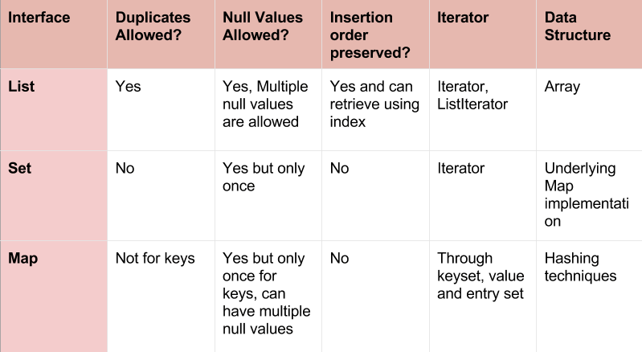
DIFFERENCE BETWEEN LIST , SET AND MAP

